Slide 1
Early Molecular Signatures of Alzheimer's disease in the Mouse Brain
Greg Carter
Assistant Professor
UCHC, 24 March 2015

Slide 2
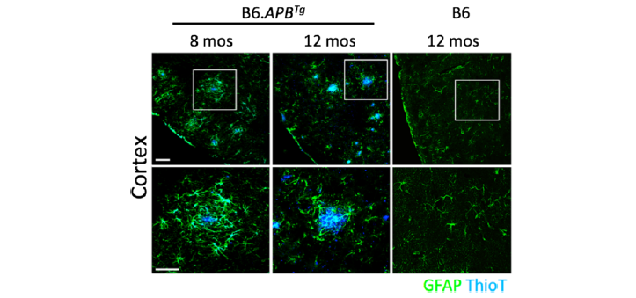
AD Mouse Model
APP/PSEN1 double transgenic
Amyloid plaques established by 8-12 months of age
in cortex and hippocampus,
associated with reactive astrocytes.
Jackson, et al. BMC Genomics, 2013
Notes:
female, plaques visualized with Thioflavin T. Present in cortex, hippocampus, etc. Plaques associated with reactive astrocytes.

Slide 3
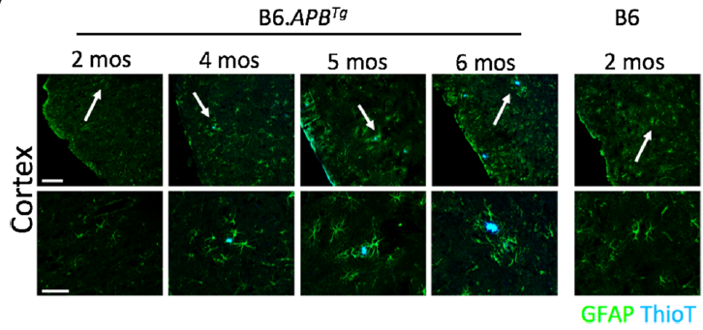
AD Mouse Model
APP/PSEN1 double transgenic
Plaques appear at 4-6 months in APP/PS1 mice.
Jackson, et al. BMC Genomics, 2013

Slide 4
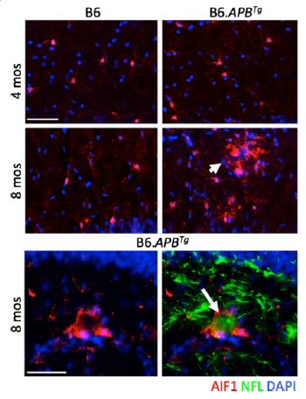
AD Mouse Model
APP/PSEN1 double transgenic
Microglia (AIF1) are activated at axonal swellings (NFL) in APP/PS1 by 8 months age.
Jackson, et al. BMC Genomics, 2013
Notes:
hippocampus.

Slide 5
Molecular Profiles of Aging Mice
RNA-seq at multiple time points
Whole brain hemispheres from female B6 WT and B6.APP/PS1 mice.
10,483 total transcripts expressed for expression analysis.
2 mo | 5 WT
 | 5 APP/PS1
4 mo | 9 WT
 | 5 APP/PS1
5 mo | 13 WT
 | 10 APP/PS1
6 mo | 7 WT
 | 5 APP/PS1
phenotypically similar,
juvenile brain.
Notes:
whole half brains

Slide 6
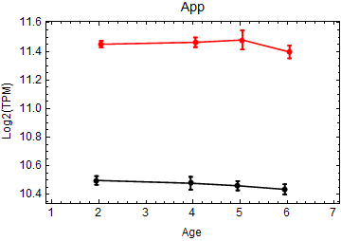
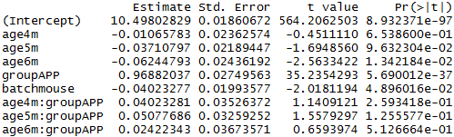
Quantitative Model of Expression
expr = μ + batch + age + genotype + age x genotype
Example: APP
WT
APP
Notes:
Require q < 0.05, R2>0.4, and then effect > 0.1

Slide 7
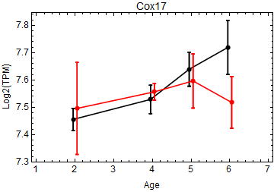
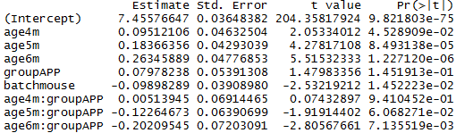
Quantitative Model of Expression
expr = μ + batch + age + genotype + age x genotype
Example: Cox17
WT
APP

Slide 8
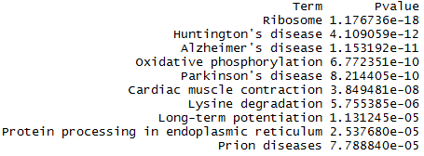
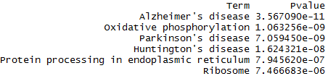
Differential Expression
1231 age-related genes
579 APP-related genes
Notes:
Same pathways – age and genotype are interactive.

Slide 9
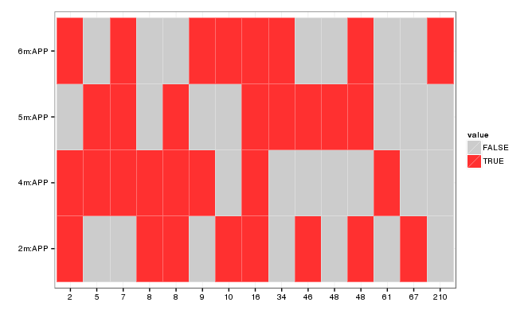
Expression by Factor
Define gene modules by common factors
APP at 6m
APP at 5m
FALSE
APP at 4m
TRUE
APP
(time-independent)
Notes:
R2>0.4 or 0.5, effect > 0.1 or 0.2

Slide 10
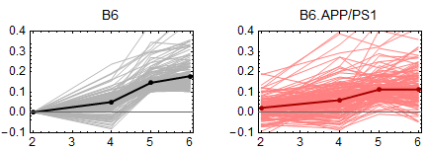
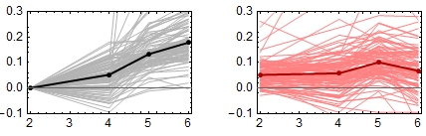
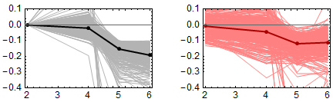
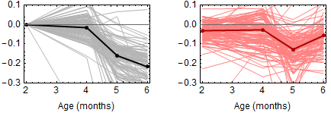
Aging Brain
N = 132
oxidation-reduction process | 2 x 10⁻⁷
metabolic processes | 7 x 10⁻⁷
ribosome | 2 x 10⁻¹⁶
Alzheimer’s disease | 1 x 10⁻³
N = 95
proton transport | 4 x 10⁻⁸
oxidative phosphorylation | 5 x 10⁻¹⁸
Alzheimer’s disease | 1 x 10⁻⁹
neurogenesis | 3 x 10⁻¹⁹
neuron differentiation | 9 x 10⁻¹⁹
long-term potentiation | 3 x 10⁻⁵
N = 276
nervous system development | 1 x 10⁻⁶
Jak-STAT signaling pathway | 3 x 10⁻⁴
N = 113

Slide 11
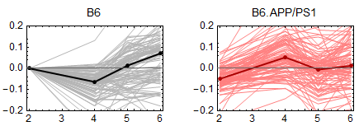
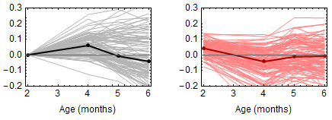
Early AD signals at 4 months
N = 36
N = 98
?
N = 99
regulation of vasodilation | 3 x 10⁻⁵
neurotrophin production | 5 x 10⁻⁵
negative regulation of vascular endothelial growth factor receptor signaling | 5 x 10⁻⁴
endocytosis | 1 x 10⁻³
chemokine signaling pathway | 3 x 10⁻³
Notes:
Early signatures, accelerated aging. Normally a 5-6 months signal appearing at 4 months.

Slide 12
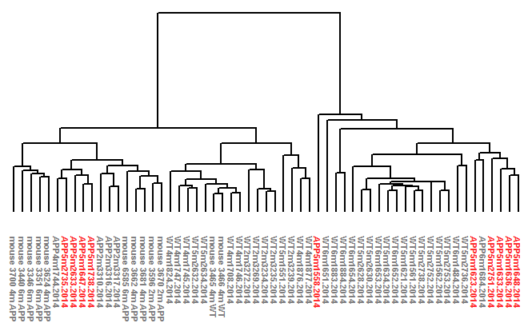
Mixed Molecular Phenotype at 5 months
AD-like
WT-like

Slide 13
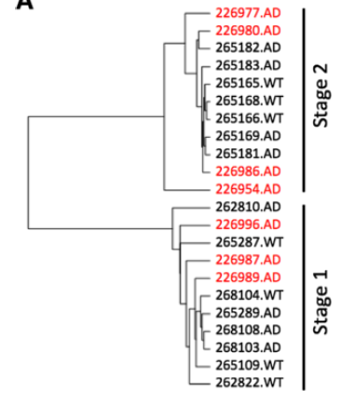
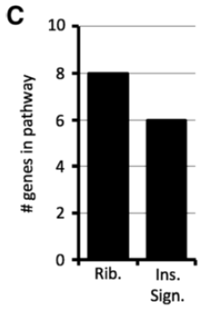
Critical Reset at 5 months?
Increased Expression in AD-like (356)
Reduced Expression in AD-like (143)
neuron development | 6 x 10⁻¹⁵
axon development | 7 x 10⁻¹³
synaptic transmission | 3 x 10⁻¹²
calcium signaling pathway | 7 x 10⁻⁶
axon guidance | 1 x 10⁻⁵
type II diabetes | 6 x 10⁻⁴
mitochondrial pyruvate transport | 2 x 10⁻⁵
negative regulation of synaptic vesicle exocytosis | 7 x 10⁻⁶
oxidative phosphorylation | 6 x 10⁻¹¹
Alzheimer's disease | 1 x 10⁻⁹
ribosome | 1 x 10⁻⁴
Stage 2
6 month
5 month
Stage 1
4 month
5 month
Jackson, et al. BMC Genomics, 2013
Notes:
AD-like versus “reset WT” at 5 months.

Slide 14


Summary
Aβ plaque deposition
astrocytosis
microglia activation
reduced development-to-metabolic transition?
increased Jak-STAT signaling/STAT3?
AD
vascular EGFR persistence?
neurotrophin deficit?
APP
PS1
APP
PS1
Neuropathology
APP
PS1
APP
PS1
2 months
4 months
~5 months
6 months
Notes:
Reset at 5 month? So now we can partition 5month APP mice and watch development, regardless of early APP effects.

Slide 15
Alzheimer’s Disease Sequencing Project
NIA’s multi-center project on genetics of late-onset AD.
Designed to identify genomic variants that increase risk of late-onset AD.
Whole genome sequencing
584 individuals from 111 families
Median age ~72 years
60% female, 40% male
Full data released in mid 2014
Exome capture sequencing
Case/control cohort of 5000/5000 individuals
First data released in late 2014

Slide 16
Alzheimer’s Disease Sequencing Project
Plans
GWAS-style analysis to identify causal SNP and small structural variants.
Prioritize variants by candidate status, expression level and location, and
astrocyte-specific epigenetic signatures (noncoding).
CRISPR/Cas9 engineering of candidate loci to create late-onset mouse models.

Slide 17

Acknowledgements
Xulong Wang Vivek Philip
Harriet Jackson Guru Ananda
Ileana Soto Ankit Malhotra
Leah Graham Krish Karuturi
Gareth Howell
Pyewacket Foundation JAX Director’s Innovation Award

